Slide 1
Sustainable community investment in action
A look at some of the R Consortium Funded Grant Projects and Working Groups
Joseph B Rickert
R Consortium Director

Slide 2
R Consortium Members

Slide 3
R Consortium Momentum
3 years since launch | $650k+ Grant dollars awarded | 28 Supported Projects | 8 Launched Working Groups
150+ Sponsored R Meetups | 15+ Supported R Community Events | 40k+ R users members of supported meetups | 3 useR! events sponsored

Slide 4
New 2018 Projects

Slide 5
DBI Project - Kirill Müller
DBI, R's database interface, is a set of methods declared in the DBI R package.
Communication with the database is implemented by DBI backends, packages that import DBI and implement its methods.
A common interface is helpful for both users and backend implementers.
The "Maintaining DBI" is a follow-up project is mostly about providing ongoing maintenance and support for:
DBI
The DBItest test suite
The three backends to open-source databases
RSQLite,
RMariaDB
RPostgres

Slide 6
Infrastructure Development - Jeroen Ooms
This project seeks to improve and maintain tools for providing binaries
On Windows: upgrade the Rtools compiler toolchain, and provide up-to-date Windows builds for the many external C/C++ libraries used by CRAN packages.
For MacOS: expand the r-hub "homebrew-cran" tap with formulas that are needed by CRAN packages but not available from upstream homebrew-core.
Eventually: lay the foundation for a reproducible build system that is low maintenance, automated as much as possible.

Slide 7
Tools and Templates for Teaching Materials - François Michonneau
This project will develop tools to facilitate the development of consistent teaching resources
Provide a technical framework to encourage collaborative lesson development
Teaching tools will be constructed from the many R resources for literate programming including:
Sweave
knitr
Rmarkdown

Slide 8
PSI Collaboration Project - Lyn Taylor (on behalf of PSI AIMS SIG)
Statisticians from the Pharmaceutical Industry (PSI) Application and Implementation of Methodologies in Statistics (AIMS) Special Interest Group (SIG) will collaborate with the R-Consortium and representatives from pharmaceutical companies to set up of an online repository.
The repository will:
Provide the tools to conduct the regulatory standard validation for R packages.
Serve as a portal for sharing existing regulatory standard validation documentation.
Store packages and make them freely available.
Companies (or individual R users) would still need to make their own assessment on whether the validation is suitable for their own use.

Slide 9
A Unified Platform for Missing Values – Julie Josse and Nick Tierney
The objective is to create a reference platform the management of missing data management that will facilitate collaboration.
The platform will:
List the existing packages, the available literature and tutorials.
Provide a platform for integrating new work on the subject.
Contain examples of analysis workflows.

Slide 10
histoRicalg – A Project to Preserve and Transfer Algorithmic Knowledge - John C Nash
Many of the algorithms underlying R code were written several decades ago in languages such as Fortran and C in which only a modest proportion of R users are fluent.
Many original authors are no longer active.
The histoRicalg project aims to:
Document and test codes older non-R code that are still part of R
Possibly creating all-R reference codes.
Teaming older and younger workers Facilitate knowledge transfer.
The initial task is to establish a working group on Algorithms Used in R .
See https://gitlab.com/nashjc/histoRicalg

Slide 11
Working Group on US Census Data – Ari Lamstein
The working group aims to make life easier for R programmers who work with data from the US Census Bureau.
The Census Data working group will:
Operate as a forum for working with census data under the guidance of the Census Bureau.
Facilitate cooperation.
Publish a guide to working with Census data in R.
Help R programmers
Select packages that meet their needs.
Navigate the various Census Bureau datasets.

Slide 12
Top Level Projects
Leaders are members of the ISC

Slide 13
RC RUGS 2018 Sponsorship Program
10 Conferences
94 User Groups
$39k in Grants

Slide 14
75 + R-Ladies Groups Worldwide

Slide 15
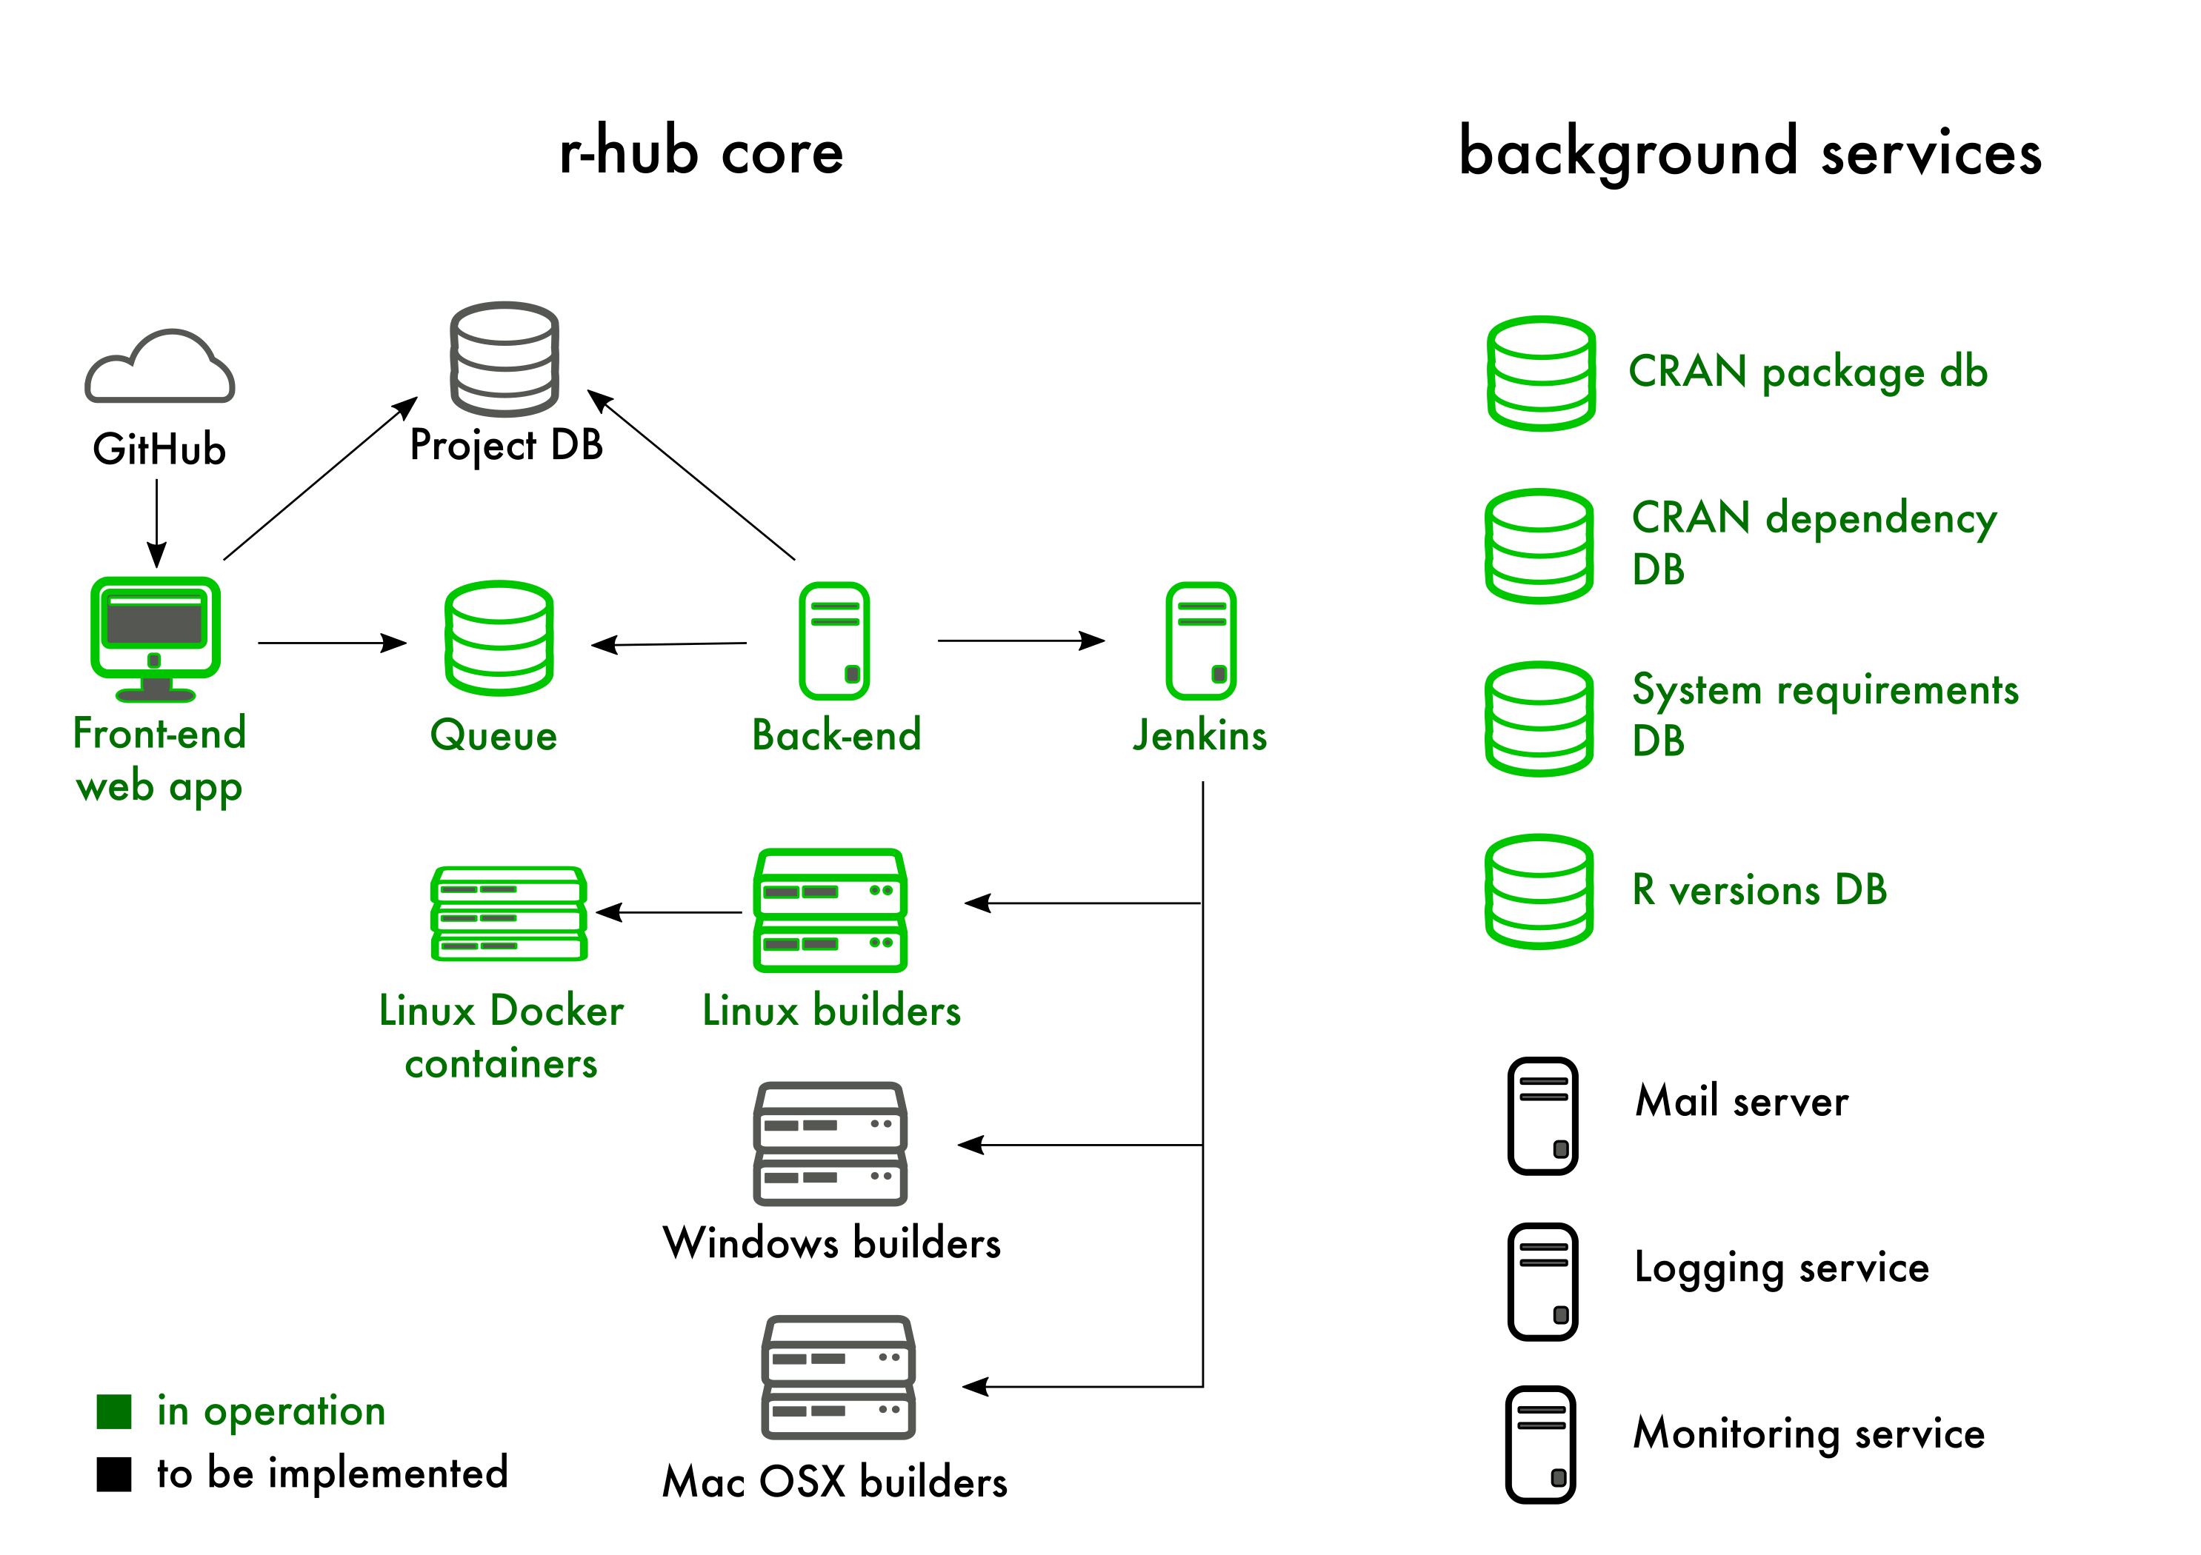
R-Hub
A service for:
Developing, building, testing and validating R packages
Simplifying the R package development process
https://builder.r-hub.io/

Slide 16
Working Groups

Slide 17
Active ISC Working Groups
Future-proof native APIs for R: This working groups will assess current native API usage, gather community input, and work towards an easy-to-understand, consistent and verifiable API that will drive R language adoption.
Code Coverage Tool for R: Helping to improve software quality, the code coverage tool will address feature and platform limitations of existing tools while also promoting the use of code coverage more systematically within the R ecosystem.
A Unified Framework for Distributed Computing in R: Develop a common framework to simplify and standardize how users program distributed applications in R
R Certification: Working to establish a common certification program for proficiency in R
R in Medicine: A community of R users in the medical industry collaborating on events and advocacy of R.
R in Pharma: A community of R users in the pharmaceutical industry collaborating on events and advocacy of R.
R Community Diversity and Inclusion Working Group: A group broadly consider how the R Consortium can best encourage and support diverse and inclusion in the R Community
Working Group on US Census Data: a forum for working with census data under the guidance of the Census Bureau.

Slide 18
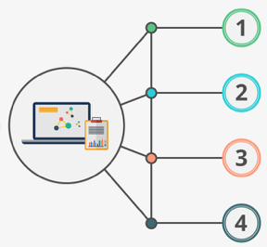
Get Involved!!
Visit R Consortium website
https://www.r-consortium.org/
Learn about ISC funded and sponsored work
https://www.r-consortium.org/projects/
Learn about the RUGS program
https://www.r-consortium.org/projects/r-user-group-support-program
Ask your company to join the R Consortium
https://www.r-consortium.org/about/join

Slide 19
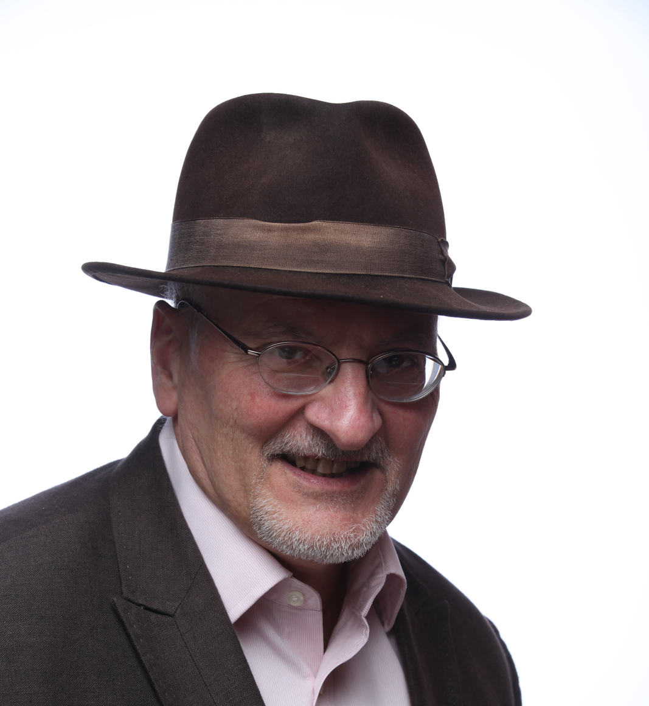
R Consortium Serving the R Community
Thank you
Joseph.rickert@RStudio.com
@RStudioJoe

